Slide 1
Emerging from the Ashes:
The evolution of leadership
Stephen J. Wiehe

Slide 2
Safe Harbor
During this presentation we may make statements related to our business that are considered forward-looking statements under federal securities laws. Words such as, but not limited to, “plan”, “expects”, “anticipates”, “believes”, “goal”, “estimate”, “potential”, “may”, “will”, “might”, “could” and similar words will identify forward-looking statements. These statements reflect our views only as of today and should not be relied upon as representing our views as of any subsequent date. These statements reflecting our current views regarding the future are subject to a variety of risks and uncertainties that could cause actual results to differ materially from expectations. For a discussion of the material risks and other important factors that could affect our actual results, please refer to our SEC filings available on the SEC’s Edgar system and our website. We encourage all investors to read our SEC filings. SciQuest expressly disclaims any obligations or undertaking to release publicly any updates or revisions to any forward-looking statements made herein, except as required by law.

Slide 3
Discussion Summary
SciQuest Transformation Timeline
My Leadership Misconceptions
Our Key Leadership Concepts
Principles We Live By

Slide 4
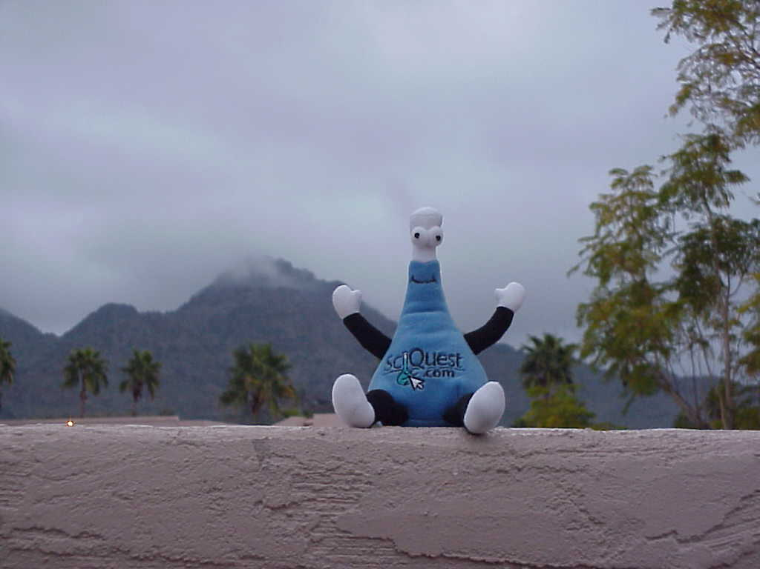
The story of Questie…

Slide 5
A little guy and a lot of money…
= $375M of Invested Capital
= $2.2B Market Capitalization _{(early 2000)}
= $60M Market Capitalization _{(late 2000)}

Slide 6
SciQuest.com
A B2B Exchange for lab supplies
“Amazon.com for the lab”
> 500 Employees
$25M per Quarter cash flow burn
(2 ½ Quarters operating cash in bank)
$64M Revenues
2.5% Gross Margin (revenue less cogs) *
$3,200 per employee
Market Cap (‘00) $2.5B
Enterprise Value less than $0
A bank, a web site, a publishing company and a software company
A charismatic CEO
A proud and headstrong culture
Founded 1996
IPO in 1999
Crashed in 2000
New CEO 2/12/01
Went Private 7/24/04
reIPO 9/24/10

Slide 7
The Mindset…
We are family….
We are changing the world….
It’s not about the numbers, it’s about doing something different…
Our culture is special; it’s something we are very proud of…
Scott says profits don’t matter – they will come in time….
We can’t be wrong, we were worth over $2B…
It’s only a short term valuation problem in that the market doesn’t really understand us right now
We are a new economy company…

Slide 8
The Change
A B2B Exchange for lab supplies
“Amazon.com for the lab”
500 Employees
$25M per Quarter cash flow burn
(2 ½ Quarters operating cash in bank)
$64M Revenues
2.5% Gross Margin *
$3,200 per employee
Market Cap (‘00) $2.5B
Enterprise Value $0
$375M of Equity raised
“It’s all about the vision”
“We are family” culture”
Understand how was value created…
LOW’ed over 400 Employees
$2M per Quarter cash flow burn
$50M at year end ‘00
Subscription fees
>70% Gross Margin
Private company (2004)
Enterprise Value $25.25M
$20M of Equity raised
“It’s all about our customers, shareholders and employees”
A new culture which is our culture today.

Slide 9



SciQuest today
Leading provider of on-demand procurement and supplier enablement solutions for indirect goods
Go-to-market strategy based on target verticals
More than 165 customers in 16 countries and 5 languages
Web-based, multi-tenant, single instance platform
Recurring revenue driven by multi-year subscription agreements
Long-term growth track record
Sept. 24, 2010—successful IPO in a tough market
Revenue (K$)
Adjusted Free Cash Flow (K$)
Customers

Slide 10
Foundation for Profitable Growth
Relentless Customer Focus
Core
Competencies
Vertical Intimacy
Financial Stewardship

Slide 11
My Leadership Misconceptions

Slide 12
Culture
Is a tangible result of….

Slide 13
Leadership

Slide 14
Leadership
and Management aren’t the same things

Slide 15
Leadership

Slide 16
Leadership Misconception #1
Leadership is a process

Slide 17
Leadership Misconception #1
Leadership is a process
Leadership is a behavior

Slide 18
Why?
You lead others by what you do, not what you say.
Transparency is a vehicle, trust is the key.
One of two states….Building or Breaking?
It must be continual, not periodic.

Slide 19
Leadership Misconception #2
A leader needs to be ready with an answer

Slide 20
Leadership Misconception #2
A leader needs to be ready with an answer
A leader needs to be ready with a question

Slide 21
Why?
Initial questions allow for clarification of the issue or problem.
Questions allow for conflict without stating such.
Questions allow you to send a message without embarrassment.
Asking for input or ideas increases power and autonomy, it doesn’t make a leader to be weak or losing power.

Slide 22
Leadership Misconception #3
A leader needs to be a great speaker

Slide 23
Leadership Misconception #3
A leader needs to be a great speaker
A leader needs to be a great speaker, but an even better listener …

Slide 24
Why?
Seek to understand – then be understood.
Instead of ‘telling’, listen to understand, understand to empathize, empathize to change.
At the center of every joke is a nugget of truth …
Most people can listen and think faster than they can talk and think …

Slide 25
Leadership Misconception #4
Great ideas come from debate and conflict

Slide 26
Leadership Misconception #4
Great ideas come from debate and conflict
Great ideas come from open, constructive and positive discussion driven by constructive questions

Slide 27
Why?
“Facilitator” style leaders are more powerful than “Directive” style leaders.
Conflict creates situations where ideas and people become positions – and positions become very hard to change.
Everyone contributes and therefore buys-in to the idea.
The situation will change over time and course correction will be required.

Slide 28
Leadership Misconception #5
A leader mandates change

Slide 29
Leadership Misconception #5
A leader mandates change
A leader can mandate change in times of crisis; in periods of growth, a leader must coax change

Slide 30
Why?
CEOs are used to being direct – “tell” is the normal behavior “ask” is more powerful and longer lasting.
Focus on positive reinforcement, not negative. Negative reinforcement looses effectiveness over time. Positive never does.
Removal of stress from a situation yields significantly better results than the addition of stress.

Slide 31
Leadership Misconception #6
A leader needs to be tough:
they set the standard
they need to maintain power and an air of authority

Slide 32
Leadership Misconception #6
A leader needs to be tough:
they set the standard
they need to maintain power and an air of authority
A leader needs to demonstrate the correct use of:
Respect
Feedback
Power
Anger

Slide 33
Why?
Respect:
Always give respect unconditionally – then you can expect it back.
Feedback
Asking for it opens a dialog.
If you are willing to receive it, you are teaching others how to receive it so they are more willing to take it.
Power:
Give power and authority away daily.
Understand where the power is and always respect the lack of it.
Anger
It’s counterproductive.
Stops all dialog and problem solving – at the worse possible time: when you need it.
People will pass it on.

Slide 34
Leadership Misconception #7
Great leaders are successful people

Slide 35
Leadership Misconception #7
Great leaders are successful people
Great leaders surround themselves with successful people

Slide 36
Why?
Growth and opportunity come from below, not above.
Behold the turtle; he makes progress only when he sticks his neck out. Get everyone to stick their necks out…
Inputs are coached and outputs are measured.
Don’t think of problems are personal. Great leaders always put needs of the company, its customers, and employees first.

Slide 37
Our Key Leadership Concepts

Slide 38
Our Key Leadership Concepts
Collaboration over consensus
Respect, trust and recognition for the individual
Facts then opinions
Proper use and respect of power
Focus on the ‘right things’
Environment
Incentive programs
Shareholder value
A hybrid of old and new management styles

Slide 39
Principles We Live By
What we’ve learned …
Or, rules we (aspire to) manage by

Slide 40
Principles We Live By
The rule of Buca di Beppo
Have an “open kitchen”

Slide 41
Principles We Live By
Have an “open kitchen” (rule of Buca di Beppo)
Measure outputs, not inputs
Coach inputs

Slide 42
Principles We Live By
Have an “open kitchen” (rule of Buca di Beppo)
Measure outputs, not inputs
First the bad news

Slide 43
Principles We Live By
Have an “open kitchen” (rule of Buca di Beppo)
Measure outputs, not inputs
First the bad news
Say what needs to be said, right time, right way

Slide 44
Principles We Live By
Have an “open kitchen” (rule of Buca di Beppo)
Measure outputs, not inputs
First the bad news
Say what needs to be said, right time, right way
Say “THANK YOU” for feedback – all feedback
Feedback is a gift

Slide 45
Principles We Live By
Have an “open kitchen” (rule of Buca di Beppo)
Measure outputs, not inputs
First the bad news
Say what needs to be said, right time, right way
Say “THANK YOU” for feedback – all feedback
Deal in facts … “seek the truth”

Slide 46
Principles We Live By
Have an “open kitchen” (rule of Buca di Beppo)
Measure outputs, not inputs
First the bad news
Say what needs to be said, right time, right way
Say “THANK YOU” for feedback – all feedback
Deal in facts … “seek the truth”
Focus on defining the problem; it should be 95% of the effort.

Slide 47
Principles We Live By
Have an “open kitchen” (rule of Buca di Beppo)
Measure outputs, not inputs
First the bad news
Say what needs to be said, right time, right way
Say “THANK YOU” for feedback – all feedback
Deal in facts … “seek the truth”
Focus on defining the problem; it should be 95% of the effort.
Focus on the journey … not the destination

Slide 48
Principles We Live By
Have an “open kitchen” (rule of Buca di Beppo)
Measure outputs, not inputs
First the bad news
Say what needs to be said, right time, right way
Say “THANK YOU” for feedback – all feedback
Deal in facts … “seek the truth”
Focus on defining the problem; it should be 95% of the effort.
Focus on the journey … not the destination
Trust & respect are key ingredients in success
You have to give them first before you can earn them
They simplify all interactions

Slide 49
Emerging from the Ashes:
The evolution of leadership
Stephen J. Wiehe

