Slide 1
Overcoming IT in Order to Support Business Functions
Fidelity Investments “Leadership in Technology” Executive Speakers Series
Dr. Saundra Wall Williams
North Carolina Community College System

Slide 2
Agenda
NC Community College System (NCCCS) Overview
Major NCCCS Initiatives (Technology +)
Overcoming IT
Leadership Strategies and Lessons Learned

Slide 3



The mission of the North Carolina Community College System is to open the door to high-quality, accessible educational opportunities that minimize barriers to post-secondary education, maximize student success, develop a globally and multi-culturally competent workforce, and improve the lives and well being of N.C. citizens.

Slide 4
Who are the students in
Community Colleges?
Traditional
  18 - 25 year olds
Non-traditional
  26 years and older
College transfer
Associate degree
Basic skills
GED
Continuing education
Displaced workers
New career
Notes:
Who are we teaching today?
The traditional vs the non-traditional come to the classroom – virtual or face to face – with different needs.
How does our eLearning address the needs of these different students?

Slide 5
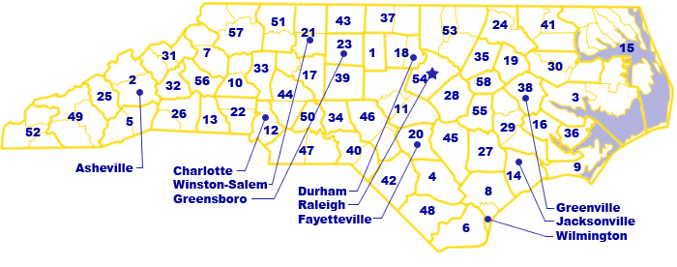
Creating Success at Colleges
Notes:
North Carolina’s community colleges open the door to high-quality, accessible educational opportunities that minimize barriers to post-secondary education. The colleges offer associate degrees, college transfer programs, job training, literacy, and adult education. The colleges maximize student success, prepare a competitive workforce that can succeed on a global stage, and offer services that improve the lives and well-being of individuals in their communities.
The 58 colleges provide an accessible opportunity for educational success to all 100 counties. There are 160 physical facilities – 58 main campuses, 28 multi-campuses and 74 off-campus sites – that bring community college classrooms within a 30-minute drive of virtually every North Carolinian, and distance learning technology reaches students in their homes and workplaces.
Community colleges provide the programs needed to build the economy by preparing students to do the jobs available now and in the future. There are more than 1,000 curriculum programs under more than 250 curriculum titles offered across the state. Programs are offered at the certificate, diploma and associate degree levels. New programs are established as a response to local and regional labor market needs and student demand.

Slide 6
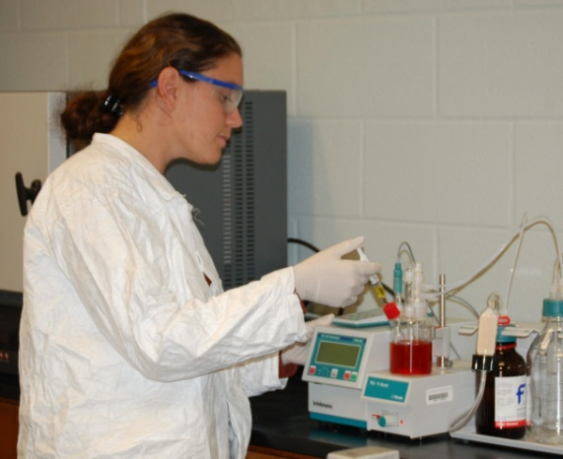


Creating Success for Students
NCCCS has approximately 900,000 students, or about 1 in 8 N.C. citizens 18 and up are enrolled in classes at one of the 58 community colleges
Notes:
Community college students have a positive effect on the state’s economy. More than 95% are in-state residents who remain and work in the state after completion, thereby contributing to the tax base.
The average age of a community college student is 32; curriculum students are slightly younger than continuing education students. About 63 percent of curriculum students are women. About two-thirds of curriculum students are white, a fourth are African-American, and 3.4 percent of curriculum students are Hispanic
More than two-thirds of community college students work while attending college and most of them have family responsibilities.
High school students greatly benefit from the partnership between public schools and community colleges. Students find flexible, seamless, student-centered educational opportunities which maximize the use of resources and educational opportunities not otherwise accessible to them through traditional high school programs.
North Carolina’s community colleges also partner with North Carolina’s public and private universities through active articulation agreements that strengthen the opportunities for transfer students seeking a four-year degree. Transfer students historically perform as well or better than native university students.
North Carolinians can find access to basic education and literacy resources at community colleges. More than 135,000 individuals honed the skills that are needed to prepare adults to seek employment.
The goal of the Basic Skills program is to give adults the ability to become full partners in the educational development of their children, and assist them in the completion of a secondary school education. Services include English as a Second Language, Adult Basic Education, General Educational Development (GED), and Adult High School.

Slide 7
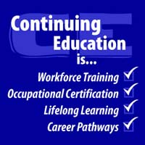


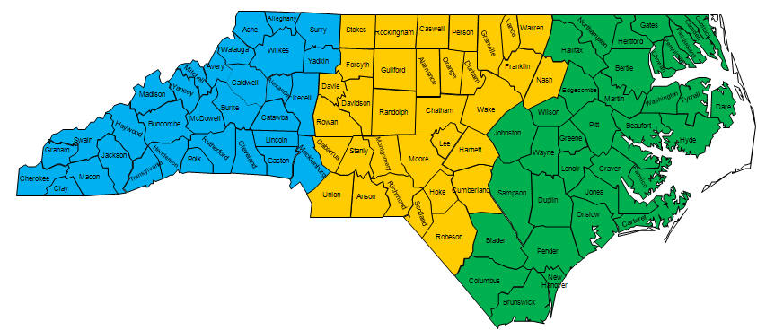

Creating Success on the Job
NC Emergency Services:
Fire, Recue, Law Enforcement
Customized Training
Notes:
Existing North Carolina businesses and industries remain competitive because of the creative and innovative customized training and/or retraining their workers received from community colleges. New and expanding companies locate or grow in North Carolina because of the free customized training their workers receive. In 2006-07, 30,108 workers of 771 existing, new or expanding companies participated in 603 skills classes or received this specialized training.
The NC Community Colleges’ BioNetwork connects the more than 20 community colleges across the state offering specialized biotechnology-related education and training for the $9.4 billion life sciences industry. BioNetwork's advanced industry training for this FDA-regulated sector is a key component in the state's strategy to meet the specialized workforce development needs of the growing biomanufacturing and pharmaceutical industry in North Carolina.
In 2006-07, the 58 Small Business Centers of the NCCCS provided free, confidential counseling for new and existing businesses. The Centers served 80,146 clients, providing counseling, training seminars and referral services to help find solutions to challenging business questions.
The Human Resource Development (HRD) program provides skill assessment services, employability skills training, and career development counseling to unemployed and underemployed adults. Growing ranks of displaced workers led to 84,310 receiving employability skills training in 2006-07.
Workforce continuing education courses provide pathways to a variety of certification, pre-licensing, license renewal, and skill development opportunities. North Carolina Community Colleges offer more than 200 courses leading to the certification and recertification required by external agencies.

Slide 8
Major IT Initiatives (Technology +)
College Information System
  The implementation of Datatel Colleague® enterprise resource planning (ERP) software at each of 59 (58 community colleges + System Office) institutions. This achievement is the result of one of the largest - and most sophisticated - technology endeavors in higher education involving multiple organizations and thousands of participants.
Notes:
CIS is only one of many initiatives this size and complexity

Slide 9
Community College Information System Overview
Reports
3rd Party Software
Enhancements
Datatel Colleague Components
Student Financial Human Resources

Slide 10
Financial System
Accounts Payable
Budget Management
Fixed Assets
General Ledger
Inventory
Physical Plant
Pooled Investments
Purchasing
Student Refunds
Projects Accounting
Human Resources
Communication Management
Personnel
Payroll
Position Budgeting
Student System
Academic Records
Accounts Receivable
Campus Organizations
Cash Receipts
Curriculum Management
Degree Audit
Faculty Information
Financial Aid
Recruitment/Admissions Management
Registrations
Residence Life
Telephone Registration
System Components

Slide 11
1. Curriculum Common Course Library
2. Curriculum Standards
3. Curriculum Program Design and Approval
4. Literacy Education
5. Human Resource Development
6. Small Business Center
7. Fire Certification
8. Developmental Education Reporting
9. Program Auditing
10. New and Expanding Industry Training
11. Career Planning and Placement
12. Research and Institutional Effectiveness
13. Regional Calendaring
14. Equipment Inventory
15. Facilities Management
16. Parking
17. Safety
17 Enhanced Applications

Slide 12
Critical Issues Impacting Implementation
Presidential Commitment (Colleges and State)
Reengineering
Integration
Consultants and Vendor Management
Implementation Time
Implementation Costs
Selecting, recruiting and retaining employees
Training employees
Employee morale

Slide 13
Initiatives, Initiatives . . .
System wide ERP Portal Implementation
NCCCS Data Initiatives
Statewide Education Longitudinal Data System
Completion By Design (Gates Foundation)
Accelerating Opportunity (Basic Skills, GED)
Math Redesign
And the list goes on and on +++++ . . . .

Slide 14

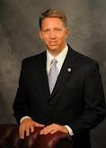
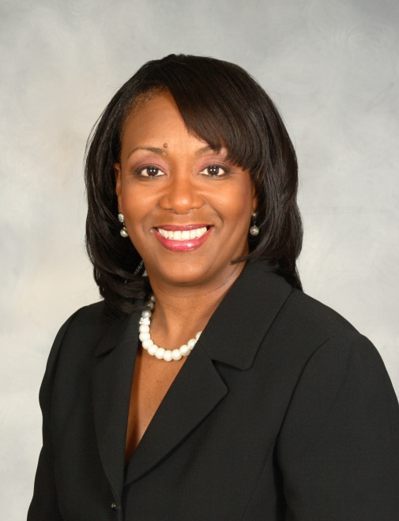
Leadership Varies . . .
Leader of IT Company
IT Leadership within a Company

Slide 15
How to Overcome IT . . .
Must learn and experience leadership from all areas of an organization.
Implement change through collaboration and team leadership
Structural
Human Resources
Political
Symbolic
Four Frames of Leadership

Slide 16
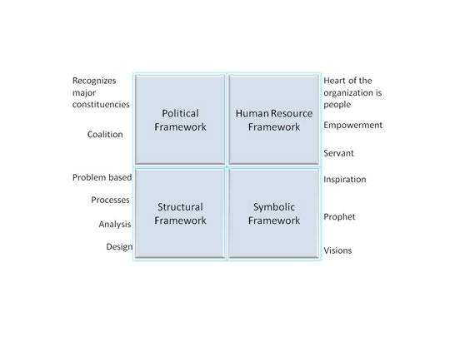

Slide 17
Structural Framework
Social architect whose leadership style is analysis and design - focus on structure, strategy, environment, implementation, experimentation, and adaptation.
Collaborative leadership in the Structural framework will require leaders to make change focusing on the structural elements within the organization as well as strategy, implementation, and adaptation.

Slide 18
Human Resource Framework
Catalyst and servant whose leadership style is support, advocate, and empowerment - visible and accessible; they empower, increase participation, support, share information, and move decision making down into the organization.
Collaborative leadership in the Human Resource framework will require leaders to approach change from a focus on people. Here the emphasis is support, empowerment, staff development, and responsiveness to employee needs.

Slide 19
Political Framework
Advocate, whose leadership style is coalition and building - clarify what they want and what they can get; they assess the distribution of power and interests; they build linkages to other stakeholders; use persuasion first, then use negotiation and coercion only if necessary.
Collaborative leadership in the Political framework will require leaders to approach change with a focus on the political realities that exist within and outside organizations. This approach emphasizes dealing with interest groups (and their varying agendas), building power bases, coalition-building, negotiating conflicts over limited resources, and creating compromises.

Slide 20
Symbolic Framework
Prophet, whose leadership style is inspiration, view organizations as a stage or theater to play certain roles and give impressions; these leaders use symbols to capture attention; they try to frame experience by providing plausible interpretations of experiences; they discover and communicate a vision.
Collaborative leadership in the Symbolic framework will require leaders to approach change with a focus on vision and inspiration. Symbolic leaders feel that people need to believe that their personal work, and the work of the organization, is important and meaningful.

Slide 21
Leadership Strategies to integrate the four frames of leadership . . .
Develop a shared vision for the project.
Develop a mutual respect for each other’s viewpoint.
Maintain open communication.
Develop trust.
Collaborate! Collaborate! Collaborate!

Slide 22
Questions?
Thank you!

