Slide 1
Building a Business on Artificial Intelligence:
Converting Financial Statements into Plain Language
Presented by: Mark Woodwell, Chief Software Engineer, Sageworks
February 21, 2013

Slide 2


Sageworks Today
Sageworks develops financial analysis solutions & provides financial data
Patented technology translates complex financial data into written financial health assessments
Largest source of accurate private-company financial data
Clients include 5,000+:
CPA & accounting firms
Financial institutions
CFOs and business owners
Expert source for the Wall Street Journal, Reuters, CNBC, Fox & Forbes
Named to the Inc. 500 & Deloitte Technology Fast 500

Slide 3

Starting Sageworks
Time spent consulting small businesses
Business owners don’t understand financial statements
The “Aha!” moment: “I'm kind of surprised someone hasn't automated this.”
A chance meeting
An ambitious undertaking
A market?
A market!
Two markets

Slide 4
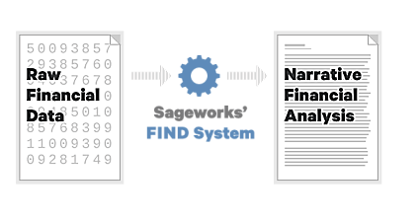
Expert System Overview
Nearly all of Sageworks' technologies are built on "FIND", a patented technology that converts financial numbers into narrative text. "FIND" is a truly expandable and adaptable technology.

Slide 5
Expert System Method
The FIND expert system is a unique method of data interpretation. The technology turns data into text by following these steps: 1) Data Acquisition
2) Relationship Analysis
3) Benchmarking & Scoring
4) Section Assembly
5) Report Assembly

Slide 6
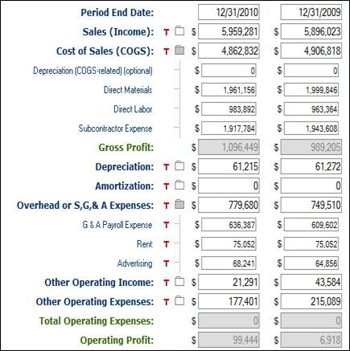
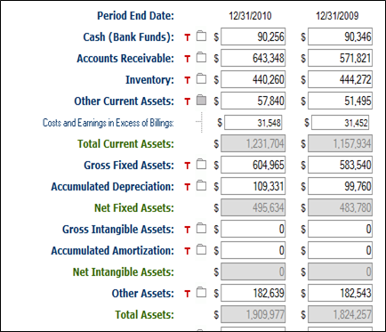
Expert System Method - Data Acquisition
Financial data is entered into the web-based applications

Slide 7
Expert System Method - Relationship Analysis
The sixteen ratios and other metrics below are calculated:
Formula | Description
01 | Current Ratio
02 | Current Ratio % change
03 | Quick Ratio
04 | Quick Ratio % change
05 | Net Profit (Income) Margin
06 | Net Profit (Income) Margin % change
07 | Net Income % change
08 | Gross Profit Margin % change
09 | Gross Profit % change
10 | Sales % change
11 | Borrowing use
12 | Total Debt % change
13 | Asset use
14 | Gross Fixed Assets % change
15 | Employee use
16 | Employee % change

Slide 8
Expert System Method - Benchmarking & Scoring
Each of the 16 ratios is scored based on parameters of the ratio and industry:
7221- Full Service Restaurants
Formula 10: Sales % Change
d- Down: Sales growth was less than -4%
m- Same: Sales growth was between -4% and 4%
r- Rise: Sales growth was between 4% and 20%
f- Significantly Rise: Sales growth was more than 20%

Slide 9
Expert System Method - Section Assembly
An example of a section key that would create a paragraph of text is S-10m-14d-16f.
This string is referring to the Sales section (S) of the report and tells the system that:
Sales have stayed the same since last period (10m)
Asset levels have fallen (14d)
Employee levels have risen significantly (16f)
The numbers 1-16 represent the 16 metrics that make up the report
10 = Sales % Change, 14 = Gross Fixed Assets % Change, and 16 = Employee % Change
D, m, r, f stand for down, same, rise, significant rise

Slide 10
Expert System Method - Report Assembly
The expert system will take this section key and select the corresponding paragraph(s) from the Text Database, forming one section of the report.
“It is relatively straightforward to understand sales changes -- they are either up or down. In this case, sales are actually about the same -- they have not changed much from last period. What may be bothersome is that sales are the same, but the employee base has risen significantly. This means that each employee is now generating fewer sales dollars. This may damage net profitability in the long run, since it is a key management read in the industry. On a more positive note, fixed assets have fallen this period, which means that the company is now moving more sales through each dollar of assets on the books. This is a positive result because it means that the company has increased "asset" turns in the business. From a sales standpoint alone, the company has managed its assets more effectively and its employees less effectively this period.”
10

Slide 11
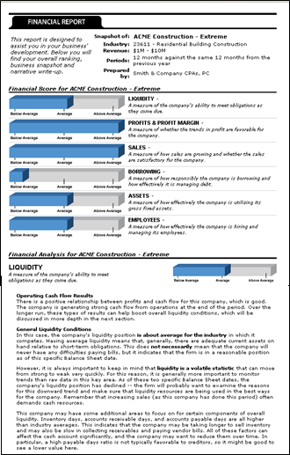
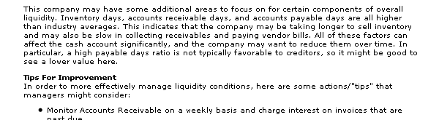
An Expert System Application: ProfitCents for Accounting Firms
Financial statement analysis for:
Value-added reports for customer development
Support for audits and review
Projections and business consulting
Loan preparation
Visit: ProfitCents.com

Slide 12
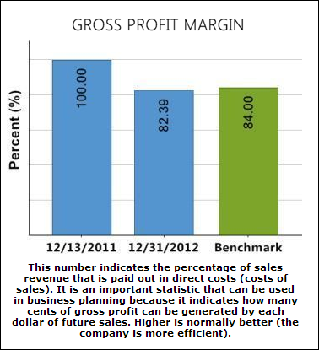
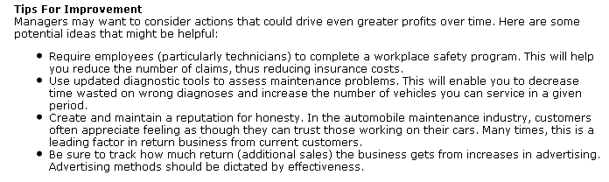
An Expert System Application: Sageworks for CFOs and Business Owners
Financial statement analysis for:
Actionable advice to increase cash flow and profitability
Benchmarking vs. industry peer group
Consumable reports for board meetings
Simple identification of areas of improvement
Visit: Sageworks.com

Slide 13
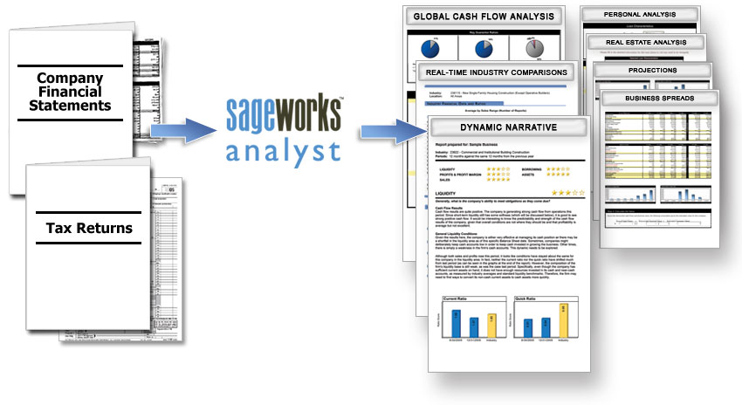
An Expert System Application: Sageworks Analyst for Financial Institutions
Financial statement analysis for:
Making commercial lending decisions
Benchmarking borrowers’ financial performance
Differentiating loan packages for prospective borrowers
Visit: SageworksAnalyst.com

Slide 14
Expert System Byproduct: Private-Company Data Aggregation
Through the use of our software, Sageworks collects and aggregates data on privately held companies
CPAs and financial institutions enter financial data
Filters and Scrubs Data
Converts Data into Reports
Calculates Industry Benchmarks
Populates Database
Sector level financial data:
Region
Sales Range
Industry
Year

Slide 15
Contact Information
Mark Woodwell
Chief Software Engineer, Sageworks
mark.woodwell@sageworksinc.com
www.sageworks.com

