Slide 1
Ground to Cloud
The Evolution of the Relational Database and Purpose-built Data-Stores.
Larry Weber,
Head of Product Marketing, Databases
AWS

Slide 2
Agenda
Introduction
Very brief timeline on databases
Purpose-built
Common data models
Evolution of relational
Customer examples
Resources

Slide 3

Cloud Computing has become the new normal
Deploying new applications to the cloud by default
AWS services more than a million active customers every month in 190 countries.
Through customer obsession and an increasing pace of innovation, AWS is the fastest technology vendor in history to reach a $10B run rate.
Migrating existing applications as quickly as possible

Slide 4



The AWS Cloud
"AWS is our trusted partner that is going to run our company for the next 140 years.”
Jim Fowler
CIO, General Electric
Eliminate costly technical debt and reallocate resources
Innovate faster and solidify your competitive advantage
Reduce risk by focusing resources dedicated to security, compliance & availability
Notes:
AWS can free you up to pursue innovative, high-value business opportunities by eliminating time spent on undifferentiated maintenance and operations. This in turn can allow you to put more resources on creating, testing, and releasing new products faster to drive more customer value and gain more competitive advantages. And, you can do it while simultaneously improving your security posture and compliance efforts.
-----
GENERAL ELECTRIC: General Electric (GE) is migrating more than 9,000 workloads, including 300 disparate ERP systems, to AWS while reducing its datacenter footprint from 34 to four over the next three years. The company is the world’s Digital Industrial Company, transforming industry with software-defined machines and solutions that are connected, responsive, and predictive. Jim Fowler, General Electric's chief information officer, noting that GE has been around for 140 years, says, "AWS is our trusted partner that is going to run our company for the next 140 years.” As an example, the GE Oil & Gas division has started this journey by migrating more than half of its core applications to AWS while achieving a 52 percent reduction in its total cost of ownership. [http://aws.amazon.com/solutions/case-studies/general-electric/]

Slide 5
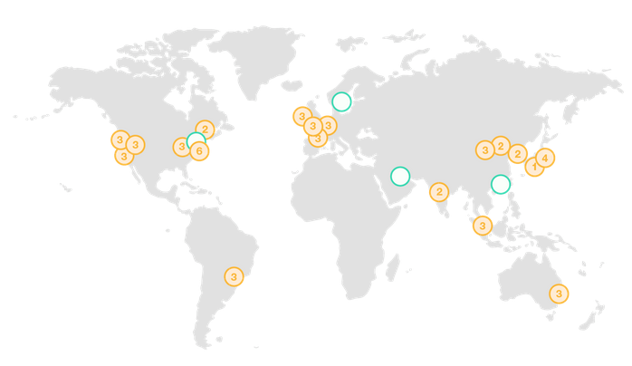
AWS Global Infrastructure
Region & Number of Availability Zones
AWS GovCloud (3) | EU
 | Ireland (3), Frankfurt (3), London (3), Paris (3)
US West | Asia Pacific
Oregon (3), Northern California (3) | Singapore (3), Sydney (3), Tokyo (4), Seoul (2), Mumbai (2), Osaka-Local (1)
US East
N. Virginia (6), Ohio (3) | China
 | Beijing (2) Ningxia (3)
Canada
Central (2) | South America
 | São Paulo (3)
Announced Regions
Bahrain, Hong Kong SAR, Sweden
18 Regions – 55 Availability Zones – 121 Edge Locations

Slide 6
AWS Pace of Innovation
1430 new features/services launched in 2017
1430
Launches
AWS has been continually expanding its services to support virtually any cloud workload.
AWS has launched a total of 1430 new features and/or services in 2017
516
159
61
As of January 2018

Slide 7
Marketplace
Mgmt. Tools
Analytics
Dev Tools
AI
IoT
Mobile
Enterprise Applications
The AWS Platform
Business Applications
Monitoring
Query Large Data Sets
Deep L. Camera
Defender
Document Sharing
DevOps Tools
Auditing
Elasticsearch
Transcribe
Translate
Management
Email & Calendaring
Business Intelligence
Service Catalog
Business Analytics
Managed Models
Analytics
VR
Hosted Desktops
Security
Server Management
Hadoop/Spark
Video
Rules Engine
Build, Test, Monitor Apps
Application Streaming
VR/AR
Account Support
Networking
Configuration Tracking
Real-time Data Streaming
Private Git Repositories
Voice & Text Chatbots
Local Compute and Sync
Push Notifications
Backup
Support
Game Development
Database & Storage
Optimization
Orchestration Workflows
Continuous Delivery
Machine Learning
Device Shadows
Build, Deploy, Manage APIs
Media
Managed Services
SaaS Subscriptions
Resource Templates
Managed Search
Build, Test, and Debug
Text-to-Speech. NLP
Device Gateway
Device Testing
Store/Convert
3D Game Engine
Professional Services
Live
Operating Systems
Automation
Managed ETL
Deployment
Image Analysis
Registry
Identity
Multi-player Backends
Partner Ecosystem
Migration
Training & Certification
Application Discovery
Application Migration
Data Migration
Database Migration
Server Migration
Hybrid
Solution Architects
Data Integration
Integrated Networking
Identity Federation
Resource Management
VMware on AWS
Devices & Edge Systems
Application
Services
Account Management
Transcoding
Step Functions
Messaging
Identity & Access
Key Storage & Management
Active Directory
DDoS Protection
Application Analysis
Certificate Management
Web App. Firewall
Security
Security & Pricing Reports
Threat detection
Aurora
MySQL
PostgreSQL
Oracle
SQL Server
MariaDB
Data Warehousing
NoSQL
Graph
Technical Acct. Management
Database
Object Storage
Archive
Exabyte-scale Data Transport
Block Storage
Managed File Storage
Select
Storage
Virtual Machines
Simple Servers
Web Applications
Auto Scaling
Batch
Containers
Event-driven Computing
Compute
Bare-Metal
Isolated Resources
Dedicated Connections
Global CDN
Load Balancing
Scalable DNS
Networking
Regions
Availability Zones
Points of Presence
Infrastructure

Slide 8
Evolution of databases
Edgar Frank Codd – 1970
The Relational Model for Databases
DynamoDB
Redis
Aurora
SQL Server
PostgreSQL
Elasticsearch
Oracle
DB2
MySQL
MongoDB
Neptune
Cassandra
Amazon Redshift
1970
1980
1990
2000
2010
As of today,
DB-Engines is tracking 340+ databases

Slide 9
Traditional Application Requirements
HR
Payroll
…
Users: 10–100k
Data volume: GB–TB
Locality: HQ
Performance: Seconds
Request Rate: Tens of thousands
Access: Internal servers, PCs
Scale: Up
Economics: Pay up front
Developer Access: Days/weeks/months
CRM
ERP

Slide 10

Modern application requirements
Users: 1M+
Data volume: TB–PB–EB
Locality: Global
Performance: Milliseconds–microseconds
Request rate: Millions
Access: Mobile, IoT, devices
Scale: Up-out-in
Economics: Pay as you go
Developer access: Instant API access
Relational
Key-value
Document
In-memory
Search
Graph

Slide 11
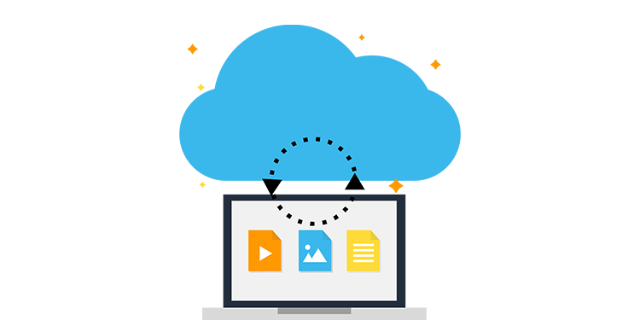

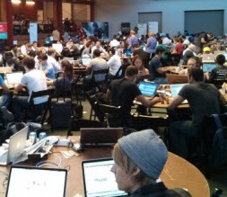
3 Key Drivers for this Evolution
Open Source
Cloud Computing
Rise of the Builder

Slide 12
purpose
noun | pur·pose | \ˈpər-pəs\
The reason for which something is done or created or for which something exists

Slide 13

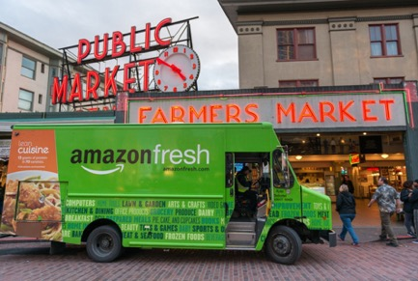


Things with purpose

Slide 14
Things with Purpose

Slide 15
Work backward from the problem you are trying to solve
Choose the right tool for each job

Slide 16

Data models and common use cases
Relational | Key-value | Document | In-memory | Graph
Referential integrity, ACID transactions, schema-on-write | Low-latency, key look-ups with high throughput and fast ingestion of data | Indexing and storing documents with support for query on any attribute | Microseconds latency, key-based queries, and specialized data structures | Creating and navigating relations between data easily and quickly
Lift and shift, ERP, CRM, finance | Real-time bidding, shopping cart, IoT device tracking | Content management, personalization, mobile | Leaderboards, real-time analytics, caching | Fraud detection, social networking, recommendation engine
Amazon Aurora Amazon RDS Amazon Redshift | Amazon DynamoDB | Amazon DynamoDB | Amazon ElastiCache for Redis & Memcached | Amazon Neptune

Slide 17
Relational
Referential integrity, ACID transactions, schema-on-write
Lift and shift, ERP, CRM, finance
time | Joe | Larry
1 | $100 | $1000
2 | +$1000 | -$1000
3 | $1100 | $0

Slide 18
Relational
Shipments
date_shipped
state
customer_id
PK
order_id
FK
Line_item
line_item_id
order_id
shipment_id
cost
PK
FK
Referential integrity, ACID transactions, schema-on-write
Lift and shift, ERP, CRM, finance
product_id
FK
FK
Customer
Products
customer_id
product_id
sku
inventory
name
description
name
notify_phone
type
PK
PK
Order
order_id
customer_id
time_ordered
complete
ship_date
order_total
tax
shipping
PK
Customer Addresses
FK
address_id
customer_id
label
street
City
Postal_code
PK
FK

Slide 19
Relational
Query:
SELECT
p.name, p.description, s.date_shipped
FROM
products as p, line_item as l, order as o, customer as c, shipments as s
WHERE
p.product_id = l.product_id AND
l.order_id = o.order_id AND
c.customer_id = o.customer_id AND
s.order_id = o.order_id AND
date_shipped >= NOW() - interval ‘30 day’ AND
customer_id = 11
Referential integrity with strong consistency, transactions, and hardened scale
Result set:
ROW: Unicorn pool float, Funny Pool Party Toys, 7-3-2018

Slide 20
Columnar
ID | Product | Cost | Quantity | Total_cost
1 | Pencil | $2.50 | 4 | $10.00
2 | Eraser | $1.75 | 1 | $1.75
3 | Paper | $3.00 | 3 | $9.00
4 | Pen | $1.00 | 5 | $5.00
5 | Stapler | $2.50 | 3 | $7.50
6 | Marker | $6.00 | 2 | $12.00
7 | Glue | $2.00 | 5 | $10.00
Product | 1:Pencil, 2:Eraser, 3:Paper, 4:Pen, 5:Stapler, 6:Marker, 7:Glue
Cost | 1:$2.50, 2:$1.75, 3:$3.00, 4:$1.00, 5:$2.50, 6:$6.00, 7:$2.00
Quantity | 1:4, 2:1, 3:3, 4:5, 5:3, 6:2, 7:5
Total_cost | 1:$10.00, 2:$1.75, 3:$9.00, 4:$5.00, 5:$7.50, 6:$12.00, 7:$10.00
SELECT
sum(Quantity)
FROM
product_table
SELECT
sum(Quantity)
FROM
product_table

Slide 21
Key-value
Highly partitionable data
Low-latency, key look-ups with high throughput and fast ingestion of data
Real-time bidding, shopping cart, IoT device tracking
Table 1
Table 2
Table N
…
…
…
…
…
…
Partitions
Partitions
Partitions
…
…
…

Slide 22
Key-value
key
value
Low-latency, key look-ups with high throughput and fast ingestion of data
Real-time bidding, shopping cart, IoT device tracking
Table
“People”

Slide 23


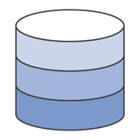
Document
!=
Indexing and storing documents with support for query on any attribute
Content management, personalization, mobile
JSON
!JSON
(client)
(app)
(database)

Slide 24
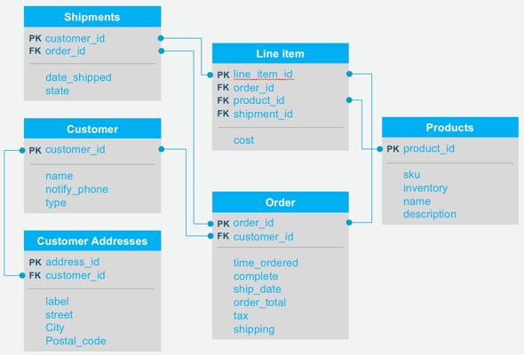
Document
{id: 34,
name: larry,
url: ‘www.aws.amazon.com”,
attributes:
[{
project: alpha,
location: kumo floor 5,
team: [{id: 3}, {id: 1}]
}]
}
Indexing and storing documents with support for query on any attribute
Content management, personalization, mobile

Slide 25

In-memory
Microseconds latency, key-based queries, and specialized data structures
Leaderboards, real-time analytics, caching
Microseconds are now the new milliseconds
(Leaderboard)

Slide 26
In-memory
Microseconds latency, key-based queries, and specialized data structures
Leaderboards, real-time analytics, caching
Query processor
Database
Get/Put APIs
Memory (Buffer pool)
Memory
Storage Engine
Disk
Milliseconds to microseconds (10x faster)

Slide 27

Graph
Creating and navigating relations between data easily and quickly
Fraud detection, social networking, recommendation engine

Slide 28
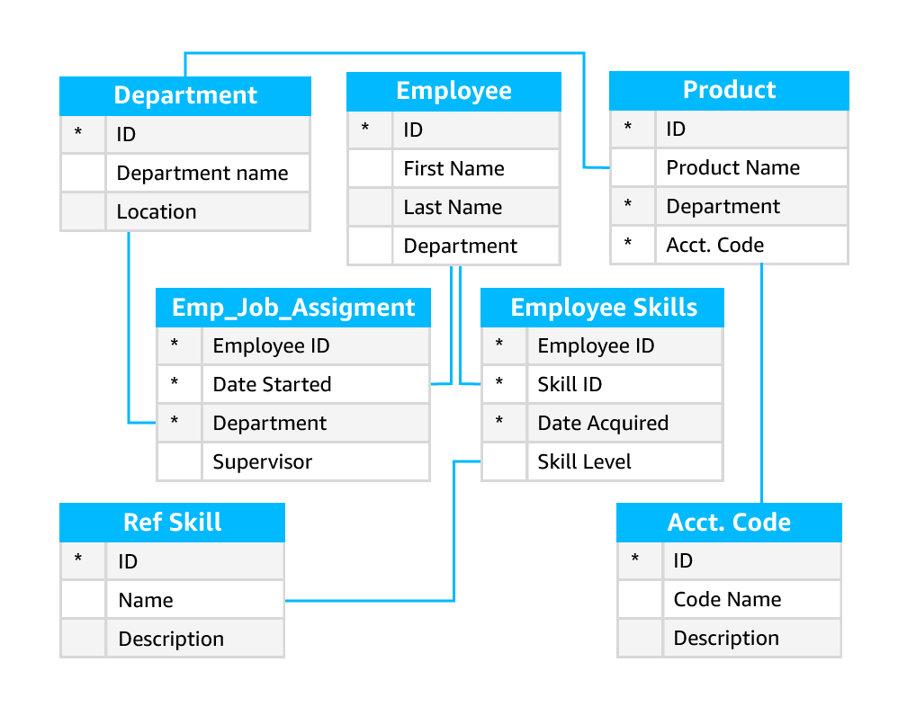
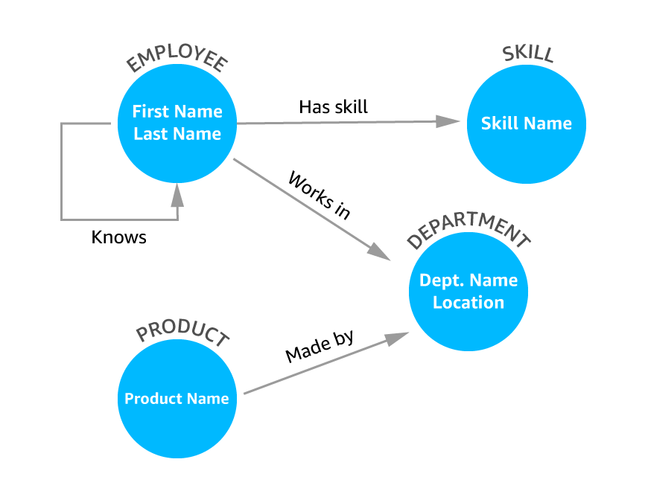
Graph
Creating and navigating relations between data easily and quickly
Fraud detection, social networking, recommendation engine

Slide 29
Data models and common use cases
Relational | Key-value | Document | In-memory | Graph
Referential integrity, ACID transactions, schema-on-write | Low-latency, key look-ups with high throughput and fast ingestion of data | Indexing and storing documents with support for query on any attribute | Microseconds latency, key-based queries, and specialized data structures | Creating and navigating relations between data easily and quickly
Lift and shift, ERP, CRM | Real-time bidding, shopping cart, IoT device tracking | Content management, personalization, mobile | Leaderboards, real-time analytics, caching | Fraud detection, social networking, recommendation engine
Amazon Aurora Amazon RDS Amazon Redshift | Amazon DynamoDB | Amazon DynamoDB | Amazon ElastiCache for Redis & Memcached | Amazon Neptune

Slide 30

Purpose-built databases example: Airbnb
Airbnb uses different databases based on the purpose
User search history: DynamoDB
Massive data volume
Need quick lookups for personalized search
Session state: ElastiCache
In-memory store for sub-millisecond site rendering
Transactional data: RDS
Referential integrity
Primary transactional database

Slide 31

Purpose-built databases example: Expedia
Expedia uses Aurora, ElastiCache, and Redshift for inventory and pricing analytics
Real-time stream processing: ElastiCache
Multi-stream union and self-join
24-hour look-back window
Transactional data: Aurora
Operational queries
Data warehousing: Redshift
Analytical queries

Slide 32





Benefits of purpose-built databases
Better
performance
More
functionality
Independence
between teams
Better scale
Easier to debug

Slide 33
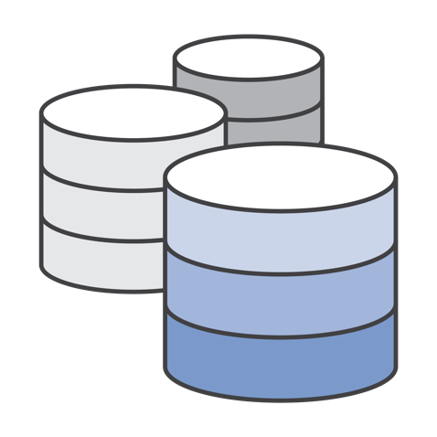
So what happens to the relational database?

Slide 34
Old-Guard Commercial Databases
Very expensive
Proprietary
Lock-in
Punitive licensing
You’ve got mail

Slide 35



Moving to Open Source Database Engines

Slide 36
Moving to Open Source Database Engines
+
Commercial-grade performance and reliability?

Slide 37
Amazon Aurora
MySQL and PostgreSQL compatible relational database built for the cloud
Performance and availability of commercial-grade databases at 1/10th the cost
Performance & scalability
5x throughput of standard MySQL and 3x of standard PostgreSQL; scale-out up to 15 read replicas
Availability & durability
Fault-tolerant, self-healing storage; six copies of data across three AZs; continuous backup to S3
Highly secure
Network isolation, encryption at rest/transit
Fully managed
Managed by RDS: no hardware provisioning, software patching, setup, configuration, or backups

Slide 38
Amazon Aurora—High Performance Scale out to millions of reads per second
Scale-out read performance
Up to 15 read replicas across three AZs
Application
Auto-scale new read replicas
Master Node
Read Replica 1
Read Replica 2
Seamless recovery from read replica failures
Shared distributed storage volume
Availability Zone 1
Availability Zone 2
Availability Zone 3

Slide 39
Aurora Serverless On-demand, auto-scaling database for applications with variable workloads
Starts up on demand, shuts down when not in use
Application
Database Endpoint
Automatically scales with no instances to manage
Scalable Database Capacity (Compute + Memory)
Warm Capacity Pool
Pay per second for the database capacity you use
Shared Distributed Storage

Slide 40
Aurora Multi-Master (Preview) First relational database to scale out reads and writes across multiple data centers
Scale-out both reads and writes
Zero application downtime from ANY instance failure
Application
Zero application downtime from ANY AZ failure
Read/Write Master 1
Read/Write Master 2
Read/Write Master 3
Faster write performance and higher scale
Shared distributed storage volume
Sign up for single-region multi-master preview today
Availability Zone 1
Availability Zone 2
Availability Zone 3

Slide 41

Customer success: Legacy databases to Aurora
Challenge:
Need to move away from expensive, legacy commercial databases to more efficient and cost-effective options.
Use case:
Used AWS Database Migration Services to move from standard PostgreSQL and expensive, legacy commercial database solutions to Aurora PostgreSQL for greater performance at lower cost.

Slide 42








































Aurora: Fastest Growing Service in AWS History

Slide 43




Amazon RDS Managed relational database service with a choice of popular database engines
Easy to administer
No need to provision infrastructure, install, and maintain DB software
Available & durable
Automatic Multi-AZ data replication; automated backup, snapshots, and failover
Highly scalable
Scale DB compute and storage with a few clicks; minimal downtime for your application
Fast & secure
SSD storage and guaranteed provisioned I/O; data encryption at rest and in transit

Slide 44












































Hundreds of Thousands of Customers Use Amazon RDS

Slide 45
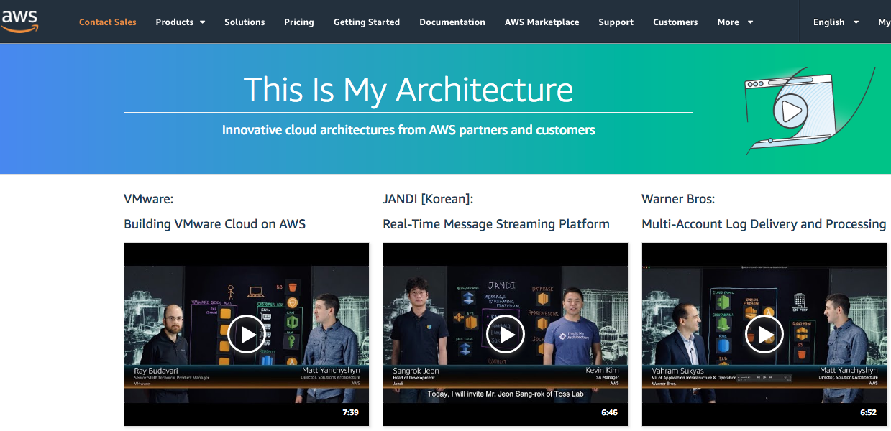
https://aws.amazon.com/this-is-my-architecture/

Slide 46
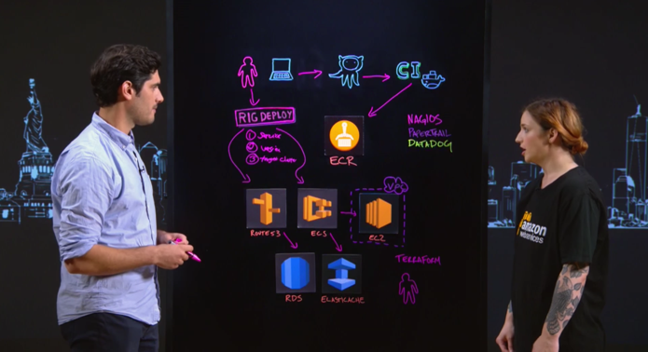


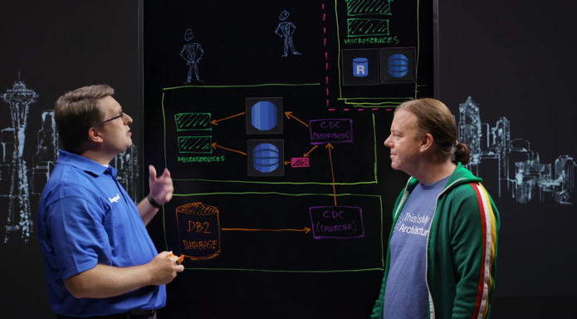

10 Steps to Using Amazon ECS, the Sixth will Blow Your Mind!
Amazon RDS
Amazon ElastiCache
Building Cloud Microservices with an on-premises system of record
Amazon DynamoDB
Amazon RDS

Slide 47
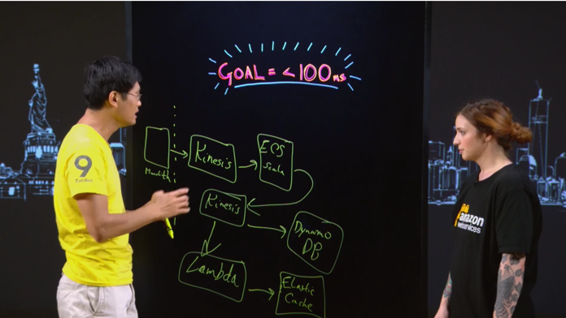
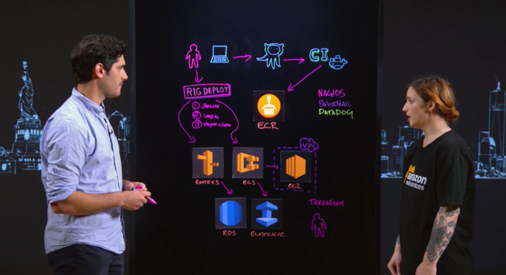
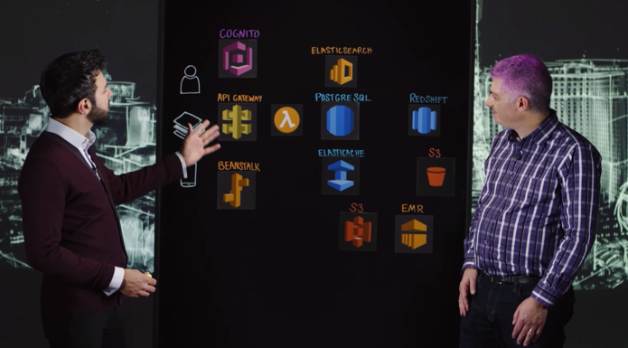


From Monolith, to Less Than 100 ms with Amazon ECS and Kinesis
Amazon DynamoDB
Amazon ElastiCache
London Stock Exchange Group: Building a Data Warehouse Using AWS
Amazon ElastiCache
Amazon RDS
Amazon Redshift
Amazon ES

Slide 48
Aurora Challenge
Aurora.devpost.com

Slide 49
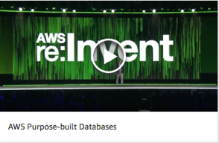
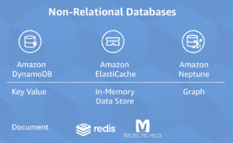
Additional resources
Andy Jassy’s re:Invent 2017 keynote: Databases
https://www.youtube.com/watch?v=1IxDLeFQKPk&feature=youtu.be&t=37m47s
Werner Vogel’s blog: A one size fits all database doesn't fit anyone
https://www.allthingsdistributed.com/2018/06/purpose-built-databases-in-aws.html
AWS Databases
https://aws.amazon.com/products/databases/

Slide 50
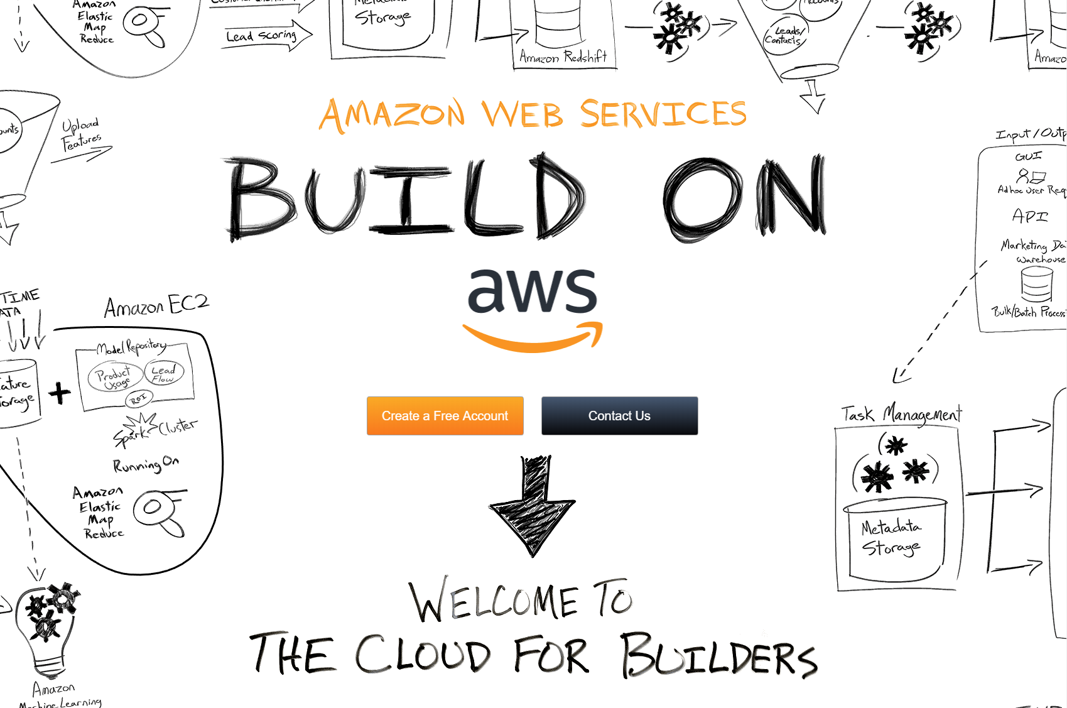

Slide 51
Thank you!

