Slide 1
Technology and Data in
Health Care: Making it Better
N.C. State University Department of Computer Science
“Leadership in Technology” Executive Speaker Series
January 24, 2013
Brad Wilson
President and CEO
Blue Cross and Blue Shield of North Carolina

Slide 2
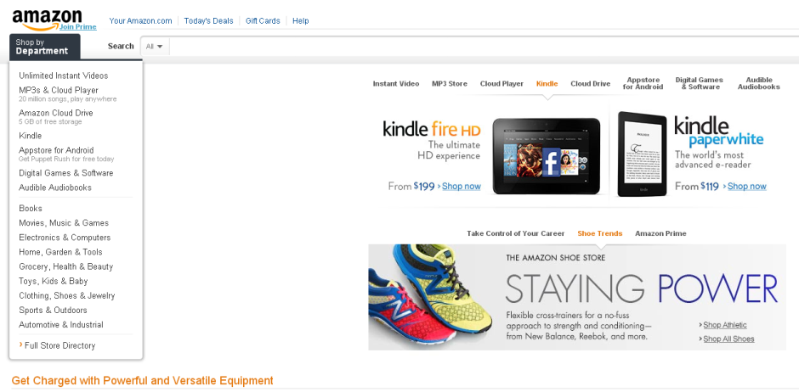
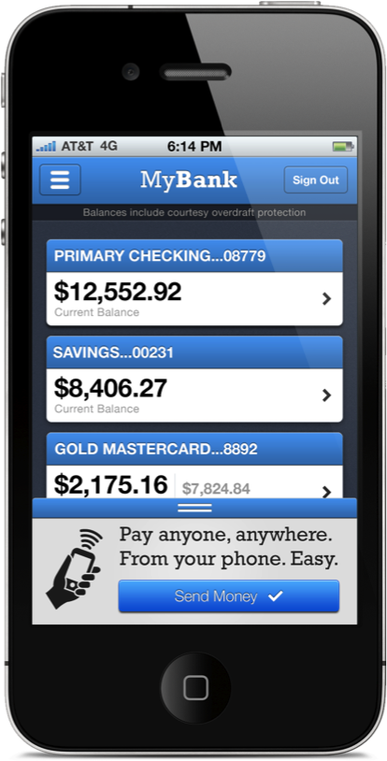

Consumer Technology
2

Slide 3

“Technology” in a Health Setting
3
3

Slide 4

What’s Wrong With Health Care?
U.S. health care expenditures
SOURCE: Health Affairs, vol. 31, no. 1 (2012): 208-219
4

Slide 5

Medical Technology: Impact on Costs
“The diffusion of advanced imaging such as CT and MRI has been rapid and has led to major increases in costs for Medicare and other payers.”
- Health Affairs, vol. 27, no. 6, November 2008
5

Slide 6

Making Health Care Better
More patient-focused
More collaborative and innovative
More effective
6

Slide 7

Carolina Advanced Health
7

Slide 8


Episodic Bundled Payments
Improve Quality
Reduce Costs
Reduce complications
Achieve surgical metrics
Achieve patient satisfaction
Meet benchmark outcomes
Reduce complications
Drive process improvements:
  Care team
  Episodic payment budget
8

Slide 9

On-site Service
9

Slide 10

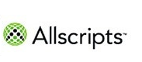


Technology and Analytics
Partnerships for health data
10

Slide 11

Opportunity
11

Slide 12
Dialogue
Brad Wilson
brad.wilson@bcbsnc.com
12

